Slide 1



chapter 1
the human

Slide 2
Review
What is HCI?
  “Human-computer interaction is a discipline concerned with the design, evaluation and implementation of interactive computing systems for human use and with the study of major phenomena surrounding them”
Disciplines involved in HCI
  Psychology & Cognitive Science
  Ergonomics: (Human Factors)
  Computer Science & System Design
Why is HCI Important?

Slide 3
Human-Computer Interaction (HCI)
Human?
  the end-user of a program
Computer?
  the machine the program runs on
  often split between clients & servers
Interaction
  the user tells the computer what they want
  the computer communicates results

Slide 4
Foundations of HCI /1
Human Cognitive psychology:
  the study of how people think and learn
  The goal of cognitive psychology is to understand the psychological processes involved in the acquisition and use of knowledge by people.

Slide 5
Foundations of HCI /2
Human Cognitive psychology:
  In order to design something for someone, we need to understand their capabilities and limitations

Slide 6
INPUT–OUTPUT CHANNELS Vision
Input in the human occurs mainly through the senses
Five major senses: sight, hearing, touch, taste and smell
Taste and smell do not currently play a significant role in HCI
Which sense is the most important of them?
Vision is undoubtedly the most important sense:
  It is very difficult to live without vision.
  It provides most of the data that we receive – megabits of data at each glance.
  It analyzes and interprets the whole scene effortlessly within a tenth of a second.
Notes:
we will first look at the human’s input–output channels, the senses and responders or effectors.
This will involve some low-level processing. Secondly, we will consider human memory and how it works. We will then think about how humans perform complex problem solving, how they learn and acquire skills, and
why they make mistakes. Finally, we will discuss how these things can help us in the design of computer systems.
Input in the human occurs mainly through the senses and output through the motor control of the effectors. There are five major senses: sight, hearing, touch, taste and smell. Of these, the first three are the most important to HCI. Taste and smell do not currently play a significant role in HCI

Slide 7
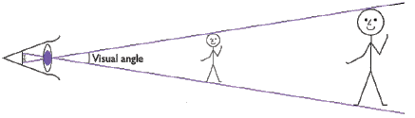
INPUT–OUTPUT CHANNELS Vision
  Visual angle indicates how much of view object occupies (relates to size and distance from eye)
    Objects of different sizes and different distances may have the same visual angle!
Notes:
Understanding the basic construction of the eye goes some way to explaining the physical mechanisms of vision but visual perception is more than this.
we will look a little more closely at how we perceive size and depth, brightness and color, each of which is crucial to the design of effective visual interfaces.
how does the eye perceive size, depth and relative distances? To understand this
we must consider how the image appears on the retina. As we noted in the previous
section, reflected light from the object forms an upside-down image on the retina.
The size of that image is specified as a visual angle. Figure 1.2 illustrates how the
visual angle is calculated.
The visual angle indicates how much of the field of view is taken by the object. The visual angle measurement is given in either degrees or minutes of arc, where 1 degree is equivalent to 60 minutes of arc, and 1 minute of arc to 60 seconds of arc.

Slide 8
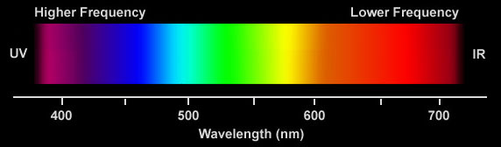
INPUT–OUTPUT CHANNELS Vision:
Color can be a powerful tool to improve user interfaces by communicating key information
Inappropriate use of color can severely reduce the performance of systems we build

Slide 9



INPUT–OUTPUT CHANNELS
Vision
Context is used to resolve ambiguity
Notes:
Visual processing compensates for the movement of the image on the retina which occurs as we move around and as the object which we see moves. Although the retinal image is moving, the image that we perceive is stable. Similarly, color and brightness of objects are perceived as constant, in spite of changes in luminance.

Slide 10


What’s below?

Slide 11
Demo

Slide 12
INPUT–OUTPUT CHANNELS
Vision:
  Negative contrast (dark characters on a light screen) improves reading from computer screen
Notes:
Contrast is the difference in luminance and /or color that makes an object (or its representation in an image or display) distinguishable.

Slide 13
INPUT–OUTPUT CHANNELS
Hearing
Provides information about environment:
distances, directions, objects etc.
Notes:
sound is changes or vibrations in air pressure
Low frequency produces low pitch
Speech is the verbal means of communicating. Speech consists of the following:
Articulation: How speech sounds are made (e.g., children must learn how to produce the "r" sound in order to say "rabbit" instead of "wabbit").
Voice: Use of the vocal folds and breathing to produce sound (e.g., the voice can be abused from overuse or misuse and can lead to hoarseness or loss of voice).
FluencyThe rhythm of speech (e.g., hesitations or stuttering can affect fluency).

Slide 14
INPUT–OUTPUT CHANNELS
Hearing (cont)
Humans can hear frequencies from 20Hz to 15kHz
Auditory system filters sounds
  can attend to sounds over background noise.
  for example,
    where we can pick out our name spoken across a crowded noisy room.
  However, if sounds are too loud, or frequencies too similar, we are unable to differentiate sound
sound can convey a remarkable amount of information
  Warning sounds and notifications

Slide 15
INPUT–OUTPUT CHANNELS
Touch or haptic
Provides important feedback about environment.
May be key sense for someone who is visually impaired.
Some areas more sensitive than others e.g.
fingers
Notes:
TouchCity

Slide 16
Memory
There are three types of memory function:
Sensory memories
Short-term memory or working memory
Long-term memory
Attention
Rehearsal

Slide 17
sensory memory
Buffers for stimuli received through senses
  iconic memory: visual stimuli
  echoic memory: aural stimuli
  haptic memory: tactile stimuli
Continuously overwritten

Slide 18
Short-term memory (STM)
  limited capacity - 7± 2 chunks

Slide 19
Examples
265397620853
212348278493202
0121 414 2626
HEC ATR ANU PTH ETR EET
The successful formation of a chunk is known as closure

Slide 20
Long-term memory (LTM)
Repository for all our knowledge
  slow access
  slow decay
  huge or unlimited capacity
Two types
  episodic – serial memory of events
  semantic – structured memory of facts, concepts, skills
  semantic LTM derived from episodic LTM

Slide 21
Long-term memory (cont.)
Semantic memory structure
  provides access to information
  represents relationships between bits of information
  supports inference
Model: semantic network
  inheritance – child nodes inherit properties of parent nodes
  relationships between bits of information explicit
  supports inference through inheritance

Slide 22
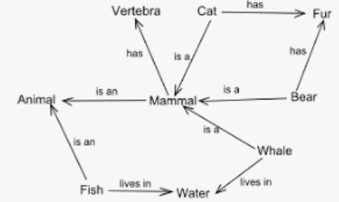
LTM - semantic network

Slide 23

LTM - semantic network

Slide 24
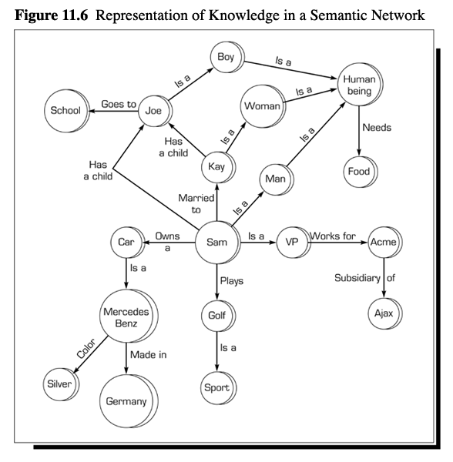
Semantic Networks

Slide 25
Models of LTM - Frames
Information organized in data structures
Slots in structure instantiated with values for instance of data
Type–subtype relationships
DOG
Fixed
legs: 4
Default
diet: carniverous
sound: bark
Variable
size:
colour
COLLIE
Fixed
breed of: DOG
type: sheepdog
Default
size: 65 cm
Variable
colour

Slide 26
Models of LTM - Production rules
Condition/action rules
  if condition is matched
  then use rule to determine action.
IF dog is wagging tail
THEN pat dog
IF dog is growling
THEN run away

Slide 27
Thinking
Reasoning
deduction, induction, abduction
Problem solving

Slide 28
Deductive Reasoning
Deduction:
  derive logically necessary conclusion from given premises.
  e.g. If it is Friday then she will go to work
  It is Friday
  Therefore she will go to work.
Logical conclusion not necessarily true:
  e.g. If it is raining then the ground is dry
  It is raining
  Therefore the ground is dry
Often truth and logical validity clash …
Notes:
Monkeys like Bananas
Lucky is Monkey Lucky likes Bananas
Rule
Case
Result

Slide 29
Inductive Reasoning
Induction:
  generalize from cases seen to cases unseen
  e.g. all elephants we have seen have trunks
  therefore all elephants have trunks.
Humans not good at using negative evidence
  e.g. Wason's cards.
Notes:
Case
Result
Rule

Slide 30
Wason's cards
7 E 4 K
If a card has a vowel on one side it has an even number on the other
Is this true?
How many cards do you need to turn over to find out?
…. and which cards?

Slide 31
Abductive reasoning
reasoning from event to cause
  e.g. Sam drives fast when drunk.
  If I see Sam driving fast, assume drunk.
Unreliable:
  can lead to false explanations

